Slide 1
Mission:Chennai Market Leadership 42%
June 21, 2022
Way Forward

Slide 2
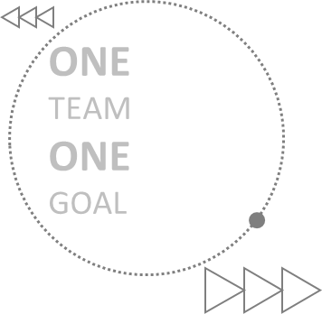
Mission :Chennai Market Leadership 42%
Objective: To achieve 42% Market share in Chennai area office
Core Team
Name | Designation
Anoop Ramesh.M | Regional Manager
Subramanian R | Area Manager
Muthukrishnan S | ASM – ICV Trucks
Sumanthran T | ASM – MDV Trucks
Niveditha M | ASM - Buses
Ashok T | TSM – C&M trucks
Ashwin C | TSM - ICV Trucks
Suresh J | ASM - Service
Pramod H Rao | RPM - Parts
Krishna Kumar M | RSM - Service
Shakespeare S | ZNM - Network
Facilitators
Sivakumar.C | Zonal Manager
Mohit Golcha | VH – Long haulage
Manoj Naidu R | VH - C&M trucks
Arunava Saha | VH – ICV trucks
Mohan K | Head - Buses
Balasubramaniam V | ZSM - Service
Sreeji JS | ZPM – Parts

Slide 3














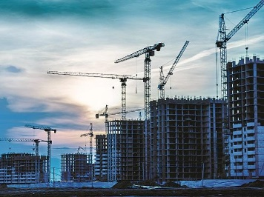
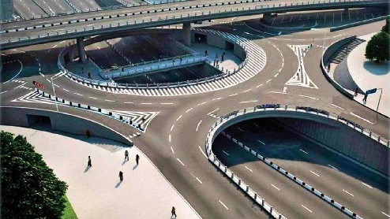




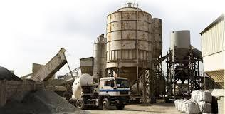



Chennai Market Overview
Automotive Manufacturers
E - Commerce
Petrochemical Industries
Infra Projects

Slide 4
Sales Volume & Market Share - Chennai
Segment | FY 21- Actual |  |  | FY 22 - Actual |  |  | FY 23 - Plan |  |  | Salience | Delta increase MS
 | AL | TIV | MS | AL | TIV | MS | AL | TIV | MS
ICV Goods | 618 | 2474 | 25.0% | 593 | 2996 | 19.8% | 975 | 3475 | 28.1% | 41% | 8.3%
Tipper | 534 | 1499 | 35.6% | 517 | 1678 | 30.8% | 925 | 1920 | 48.2% | 23% | 17.4%
MAV | 311 | 640 | 48.6% | 440 | 870 | 50.6% | 545 | 950 | 57.4% | 11% | 6.8%
Haulage | 202 | 428 | 47.2% | 301 | 724 | 41.6% | 360 | 750 | 48.0% | 9% | 6.4%
Tractor | 127 | 342 | 37.1% | 213 | 585 | 36.4% | 285 | 555 | 51.4% | 7% | 14.9%
Trucks | 1792 | 5383 | 33.3% | 2064 | 6853 | 30.1% | 3090 | 7650 | 40.4% | 90% | 10.3%
ICV Bus | 42 | 151 | 27.8% | 51 | 244 | 20.9% | 100 | 390 | 25.6% | 5% | 4.7%
MDV Bus | 161 | 186 | 86.6% | 140 | 169 | 82.8% | 370 | 440 | 84.1% | 5% | 1.3%
Bus | 203 | 337 | 60.2% | 191 | 413 | 46.2% | 470 | 830 | 56.6% | 10% | 10.4%
Trucks & Bus | 1995 | 5720 | 34.9% | 2255 | 7266 | 31.0% | 3560 | 8480 | 42.0% | 100% | 10.9%

Slide 5
Target segment for FY 23
2
3
, 48.2%
, 84.1%
, 57.4%
, 51.4%
, 25.6%
, 48.0%
, 84%
, 82.8%
, 19.8%
, 30.8%
, 50.6%
, 41.6%
, 36.4%
, 21%
, 83%
, 25.0%
, 35.6%
, 48.6%
, 47.2%
, 37.1%
, 28%
, 87%

Slide 6
Heat Map FY 22 - Actual
* Top Left corner - Segment contribution within branches
* Bottom right corner - Branch contribution across segment
Segment | Poonamalle |  |  | Madhavaram |  |  | Padappai |  |  | Vellore |  |  | Villupuram |  |  | Pondicherry |  |  | AO Chennai
ICV | 36.3 |  |  | 25.8 |  |  | 18.0 |  |  | 9.8 |  |  | 7.2 |  |  | 2.8 |  |  | 100.0
 | 21.0 |  |  | 12.5 |  |  | 11.9 |  |  | 35.3 |  |  | 29.6 |  |  | 42.9 |  |  | 19.8
 |  |  | 38.2 |  |  | 48.9 |  |  | 50.2 |  |  | 43.6 |  |  | 48.2 |  |  | 37.2 |  |  | 43.7
4x2 Haulage | 59.4 |  |  | 24.0 |  |  | 1.6 |  |  | 5.9 |  |  | 5.9 |  |  | 3.1 |  |  | 100.0
 | 36.1 |  |  | 52.9 |  |  | 77.8 |  |  | 67.6 |  |  | 64.7 |  |  | 94.4 |  |  | 46.2
 |  |  | 12.0 |  |  | 8.7 |  |  | 0.8 |  |  | 5.0 |  |  | 7.6 |  |  | 8.0 |  |  | 8.4
MAV | 36.8 |  |  | 31.6 |  |  | 7.6 |  |  | 14.8 |  |  | 6.5 |  |  | 2.7 |  |  | 100.0
 | 47.5 |  |  | 48.8 |  |  | 41.4 |  |  | 77.9 |  |  | 88.0 |  |  | 85.7 |  |  | 55.6
 |  |  | 9.9 |  |  | 15.3 |  |  | 5.4 |  |  | 16.7 |  |  | 11.2 |  |  | 9.3 |  |  | 11.2
Tractor | 51.7 |  |  | 41.5 |  |  | 0.9 |  |  | 5.6 |  |  | 0.4 |  |  | 0.0 |  |  | 100.0
 | 31.4 |  |  | 55.7 |  |  | 0.0 |  |  | 7.7 |  |  | 0.0 |  |  |  |  |  | 39.7
 |  |  | 8.5 |  |  | 12.3 |  |  | 0.4 |  |  | 3.8 |  |  | 0.4 |  |  | 0.0 |  |  | 6.8
Tipper | 33.2 |  |  | 14.2 |  |  | 27.4 |  |  | 10.8 |  |  | 8.4 |  |  | 6.0 |  |  | 100.0
 | 36.0 |  |  | 43.0 |  |  | 18.7 |  |  | 29.4 |  |  | 31.7 |  |  | 10.0 |  |  | 29.6
 |  |  | 19.3 |  |  | 14.8 |  |  | 42.3 |  |  | 26.6 |  |  | 31.0 |  |  | 44.2 |  |  | 24.2
Trucks | 38.7 |  |  | 24.5 |  |  | 16.5 |  |  | 10.0 |  |  | 6.8 |  |  | 3.5 |  |  | 100.0
 | 30.3 |  |  | 31.4 |  |  | 16.9 |  |  | 41.7 |  |  | 39.5 |  |  | 36.3 |  |  | 30.3
 |  |  | 87.9 |  |  | 100.0 |  |  | 99.2 |  |  | 95.9 |  |  | 98.4 |  |  | 98.7 |  |  | 94.3
Bus | 87.9 |  |  | 0.0 |  |  | 2.3 |  |  | 7.2 |  |  | 1.8 |  |  | 0.8 |  |  | 100.0
 | 49.9 |  |  |  |  |  | 33.3 |  |  | 46.4 |  |  | 28.6 |  |  | 33.3 |  |  | 48.7
 |  |  | 12.1 |  |  | 0.0 |  |  | 0.8 |  |  | 4.1 |  |  | 1.6 |  |  | 1.3 |  |  | 5.7
M&HCV | 41.5 |  |  | 23.1 |  |  | 15.7 |  |  | 9.9 |  |  | 6.5 |  |  | 3.3 |  |  | 100.0
 | 32.7 |  |  | 31.4 |  |  | 17.0 |  |  | 41.9 |  |  | 39.3 |  |  | 36.3 |  |  | 31.4
 |  |  | 100.0 |  |  | 100.0 |  |  | 100.0 |  |  | 100.0 |  |  | 100.0 |  |  | 100.0 |  |  | 100.0

Slide 7

Network Adequacy
200
1,500
3,000
Dist. | FY22 | AL Network |  |  | TML Network
 |  | Dealer | ASC | Total | Dealer | ASC | Total
Chennai |  | 1 | 1 | 2 | 2 | 2 | 4
Thiruvallur |  | 2 | 1 | 3 | 2 | 1 | 3
Kanchipuram |  | 1 | 3 | 4 | 0 | 1 | 1
Chengalpet |  | 0 | 1 | 1 | 1 | 0 | 1
Villupuram |  | 1 | 0 | 1 | 0 | 0 | 0
-Pondy |  | 1 | 0 | 1 | 0 | 0 | 0
Cuddalore |  | 0 | 0 | 0 | 1 | 1 | 2
Kallakutichi |  | 0 | 0 | 0 | 0 | 0 | 0
Tiruvannamalai |  | 0 | 0 | 0 | 0 | 0 | 0
Tirupattur |  | 0 | 1 | 1 | 0 | 0 | 0
Vellore |  | 1 | 0 | 1 | 1 | 1 | 2
Ranipet |  | 0 | 1 | 1 | 0 | 0 | 0
Total |  | 7 | 8 | 15 | 7 | 6 | 13
TIV ¹
MS ¹
> 40 %
33 %
25% - 40%
TIRUVALLUR
< 25 %
THIRUVALLUR
CHENNAI
42 %
25 %
VELLORE
RANIPET
KANCHIPURAM
VELLORE
42 %
17 %
42 %
TTIRUPATTUR
TIRUVANNAMALAI
CHENGALPET
TIRUVANNAMALAI
17 %
42 %
42 %
39 %
VILLUPURAM
36%
5 more touch points will be added
KALLAKURICHI
KALLAKURICHI
PONDICHERRY
39 %
CUDDALORE
CUDDALORE
39 %
Org | 3S Outlets | ASC | Total Outlets
 | 7 | 8 | 15
 | 7 | 6 | 13
Action Plan (with timelines):
Tiruvannamalai LOI issued – inauguration planned in July 1st week
Ulundurpet (Kallakurichi Dist) LOI WIP.- Inauguration planned last week of Oct’22
Vadalur (Cuddalore Dist) prospect identification WIP.
Sriperumbudur (Poonmallee 2) prospect identification WIP.
Koyambedu – at site support through WOW operations for ICV trucks & Omni Bus .

Slide 8
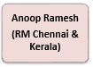
Feet on Street - AL
Subramanian
AM
Muthukrishnan (ASM ICV)
Ashwin
(TSM ICV)
Suresh
(TSM ICV)
Sumanthran
(ASM LH &Tipper)
Ashok
(TSM Tipper)
Niveditha
(ASM Bus)
Senthil
(TSM LH)
Requirement –
1 TSM for Vellore
1 TSM for Villupuram & Pondy
1 TSM for ICV Madhavaram outlet

Slide 9






Feet on street – Channel partners
OEM | Dealers | ICV Goods | Tippers | LH | Bus | Common | Total
 | TVS | 24 | 7 | 8 | 1 | 10 | 50
 | VST, POPULAR , VIJAI | 27 | 9 | 10 | 10 | 7 | 63
 | KUN TRUCKING | 12 | 4 | 4 | 1 | 4 | 25
 | JAI , COCO | 26 | 3 | 6 | 6 | 1 | 42
 | MAX TRUCKS |  |  |  |  | 12 | 12
 | SELVI AUTO / SRM | 5 |  |  |  | 2 | 7
Required | Actual | Gap
65 | 50 | 15
*TVS have agreed to add 10 DSEs by 15th Aug.

Slide 10
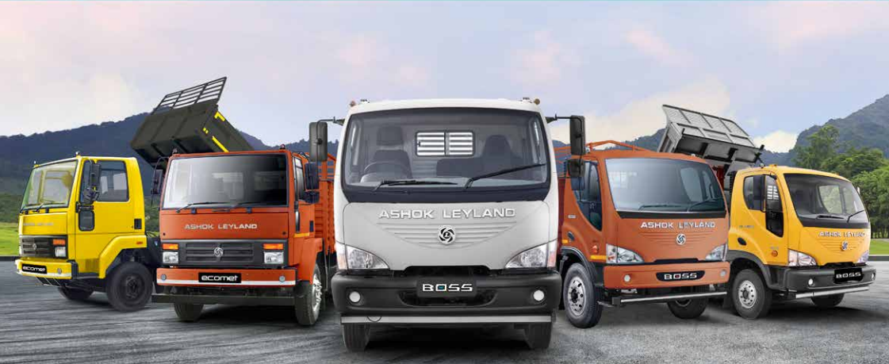
Action Plan – ICV Trucks

Slide 11
ICV Trucks Major challenge - Market coverage
- Major blind spot
Inference –
50% of the TIV - blind spot.
3 outlets (PME, MDM & PDP) covers the major blind spot in TIV.

Slide 12
Sub-segment wise contribution in ICV TIV
25%
20%
38%
36%
0%
22%
0%
0%
0%
20%
AL MS FY 21
AL MS FY 22

Slide 13
ICV - 12T Application wise action plan
Application (Contri.) | Area to focus / Hubs | Action Plan | Timeline
E-commerce (24%) | Madhuravoyal, Guindy & Madhavaram | # E- Commerce customer database collection # Test drive campaigns at Major warehouses # Required higher LTV for container requirement | 7th July
Auto Parts (20%) | Madhuravoyal, Tambaram & Madhavaram | # Performance establishment by video testimonials # Continuous engagement with customers | 15th July
Market load (19%) | Guindy, Madhavaram, Madhuravoyal & Tambaram | # Loan mela at Guindy- HLF Madhavaram - HDB & Oragadam - Chola # Existing customer testimonial establishment | Quarterly
White goods (13%) | Guindy, Madhavaram & Madhuravoyal | # Guindy, Ekkatuthangal association engagements. # Banners or Hoardings at Van stands # Financiers (Yes Bank & HDFC) and DSA Engagement | End of July
Couriers (12%) | Guindy & Madhuravoyal | # Vendor list collection from DHL, Bluedart & Gati from warehouses # Existing customer testimonial establishment | 1st week of Aug
Fruits & Vegetables (8%) | Madhuravoyal | # Existing customer testimonial distribution to all shops # Association sponsorship for stand # Regular service support through WOW | Mid of July
Poultry (4%) | Madhavaram & Guindy | # Customer database collection from association # Testimonial broadcast to all association members | Mid of August
LY MS | TIV Est. | Plan MS
7% | 320 | 20%
LY MS | TIV Est. | Plan MS
23% | 265 | 25%
LY MS | TIV Est. | Plan MS
17% | 210 | 23%
LY MS | TIV Est. | Plan MS
11% | 175 | 25%
LY MS | TIV Est. | Plan MS
16% | 160 | 25%
LY MS | TIV Est. | Plan MS
10% | 100 | 30%
LY MS | TIV Est. | Plan MS
2% | 45 | 15%

Slide 14
ICV - 15T Application wise action plan
Application | Areas to focus / Hubs | Action Plan | Timeline
Cement | Guindy, Madhavaram & Tambaram | # Current monthly sales 4/month, Target no. - 10/month # Existing customer testimonial collection / circulation # Engaging with after market team | End of July
Bricks / Steel | Guindy, Gummidipoondi & Thiruvallur | # Current monthly sales 2/month, Target no. - 5/month # Customer database collection from existing customers # Seeded 15T for red bricks # Testimonial collection & circulation # Seeding Ecomet 1815 to steel application (Over load) | 15th July
Market load | Madhavaram & Guindy | # Targeting single axle customers hubs with Ecomet 1815 # Ecomet 1815 launch at Madhavaram & Guindy association # Operating economics superiority for competition customers | 15th July
LY MS | TIV Est. | Plan MS
58% | 180 | 75%
LY MS | TIV Est. | Plan MS
25% | 80 | 40%
LY MS | TIV Est. | Plan MS
40% | 80 | 50%

Slide 15
ICV - CNG Application wise action plan
Application | Areas to focus / Hubs | Action Plan | Timeline
E-Commerce | Madhuravoyal, Madhavaram & Guindy | # User trail for 20ft container customers # Special seeding price for establishment # Pre approved loan through HLFL for strategic customers | End of July
White goods | Madhuravoyal, Madhavaram & Guindy | # Test drive campaigns at major white goods warehouses # Vehicle display at major body builder sites (Lakshmi, Kathirvel & ST) # User trial of potential competition customers | 15th July
Cement / Steel | Guindy & Madhavaram | # Product establishment of PRR 15T CNG vehicle # Alwar plant visits # Mileage muqablas at competition customer plants | 30th June
Market load | Guindy, Tambaram & Madhavaram) | # CNG product superioirty training to major finance teams (for lead generation) # Testimonial establishment through digital campaigns | End of July
LY MS | TIV Est. | Plan MS
0% | 210 | 20%
LY MS | TIV Est. | Plan MS
0% | 110 | 25%
LY MS | TIV Est. | Plan MS
1% | 65 | 50%
LY MS | TIV Est. | Plan MS
0% | 40 | 30%

Slide 16
ICV - Target customers of FY’ 23
S.No | Customer Name | Application | Major Segment | Likely Purchase qty in FY'23 | SPOC | Customer type | Action Plan | Timeline
1 | Bullet logistics | Parce load | 15T | 80 | Anoop | TML loyal | 11T CNG user trial | June
2 | SMV Enterprises | E- Commerce | 12T | 40 | Subramanian | TML loyal | 11T CNG user trial | August
3 | Ammayapper Transport | Cement | 12T | 30 | Anoop | Switcher Customer | Regular after market support (Service & Spares) | July
4 | Haven Infra | Cement | 15T | 30 | Muthukrishnan | Switcher Customer | Regular interactions & financing support | June
5 | Sri Saradha Logistics | Cement | 15T | 25 | Muthukrishnan | AL Loyal | Engagement with after market team | July
6 | DYM Logistics | Cement | 15T | 25 | Anoop | EML loyal | Regular after market support | July
7 | Mahaveer transport | Parce load | 12T | 25 | Muthukrishnan | EML loyal | VVC and plant visits | Q2
8 | Welcome transport | Market load | 12T | 20 | Muthukrishnan | EML loyal | 11T CNG user trial & Plant visits | Q2
9 | Antony Raj Tpt | Market load | 12T | 20 | Subramanian | TML loyal | Plant visits & User trials | Q2
10 | Seenu Tpt | Parcel Load | 12T | 20 | Ashwin | EML loyal | Ecomet vehicle product establishment by user trials | July
11 | Aachi Masala | Packaged Food | 12T | 15 | Muthukrishnan | Switcher Customer | 11T CNG user trial | August
12 | Janakiraman Tpt | Market load | 10T | 15 | Ashwin | EML loyal | Plant visits | Q2
13 | T3N logistics | Air cargo | 12T | 10 | Suresh | EML loyal | Video testimonial and establishment | August
14 | Deep Freeze | Reefer container | 12T | 10 | Muthukrishnan | Switcher Customer | Seeding 11T CNG for reefer application | Q3
15 | Raghavendra Tpt | Auto Parts | 12T | 10 | Subramaniam | Switcher Customer | VVC and plant visits | Q2

Slide 17
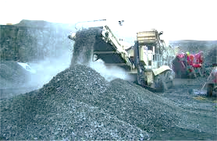
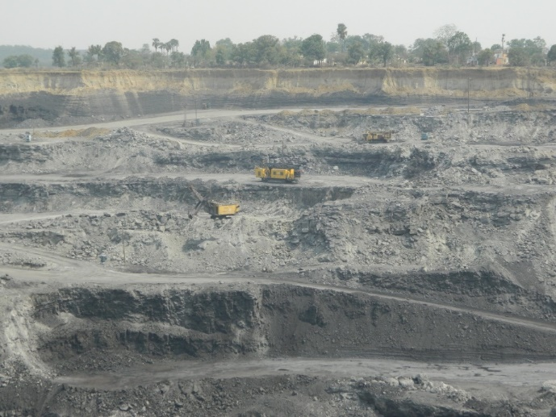
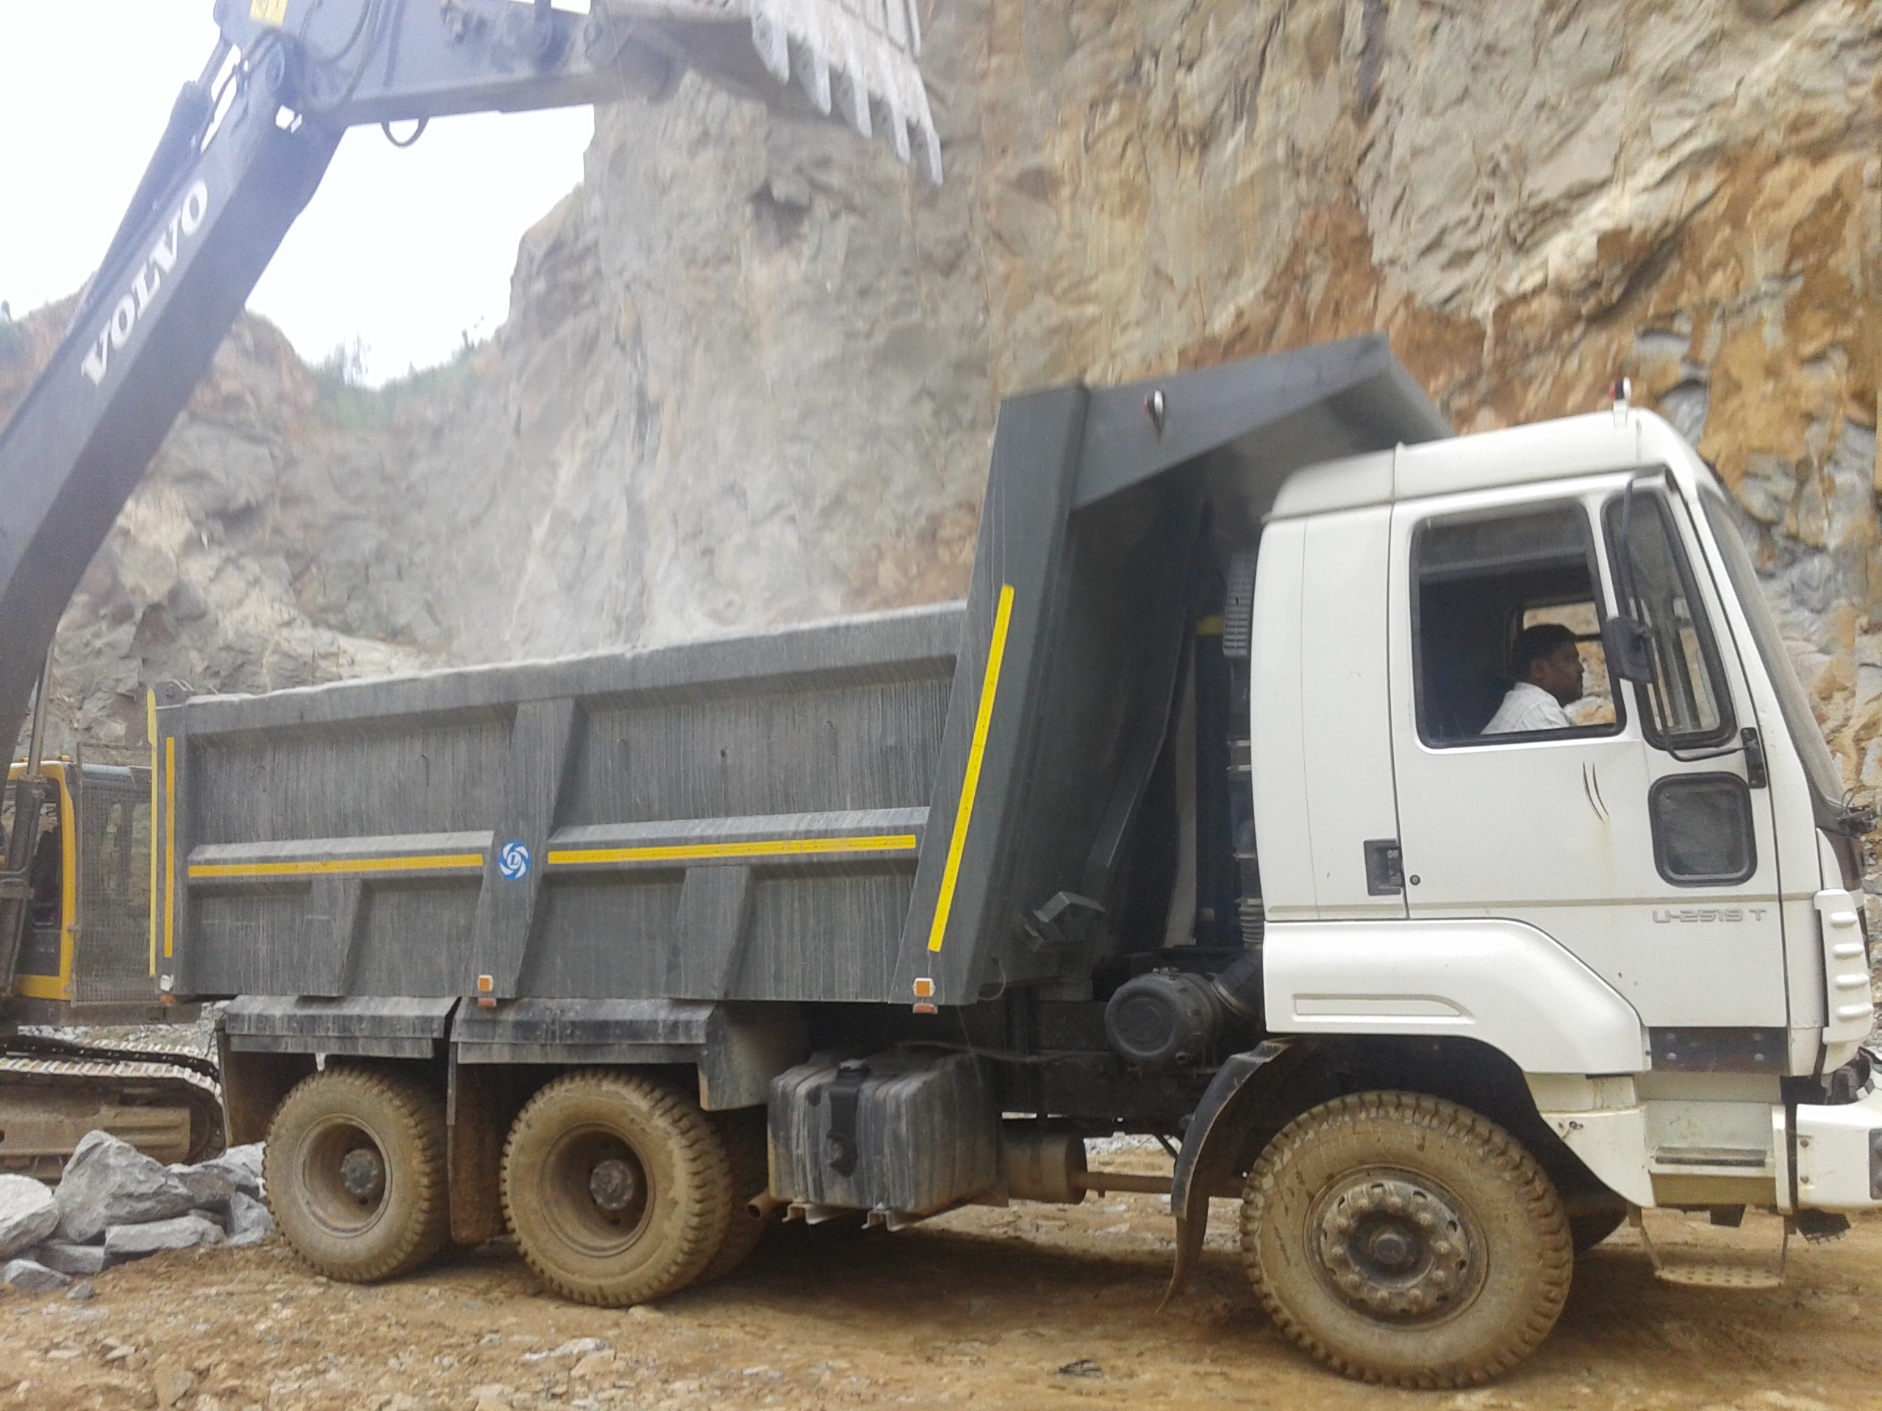
Action Plan – Tippers

Slide 18
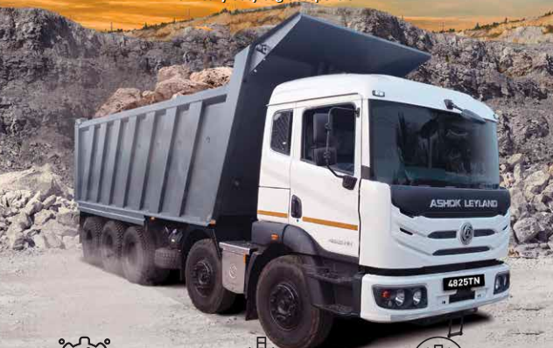
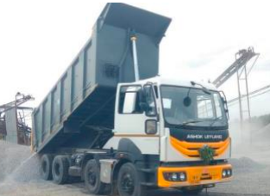
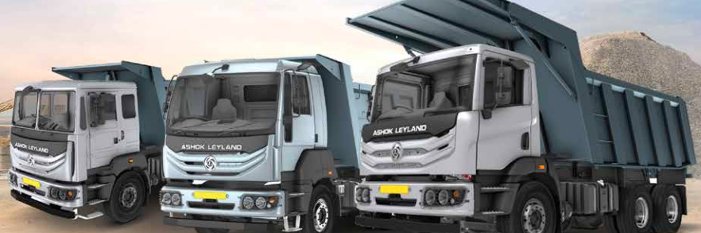
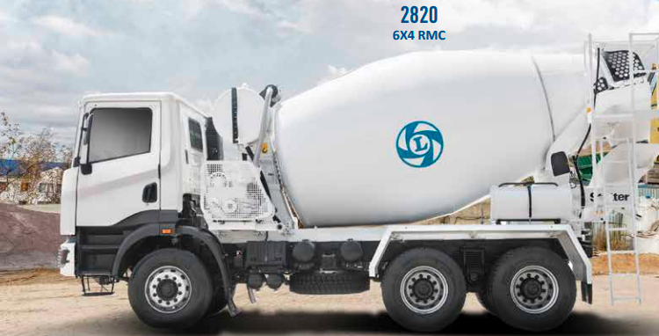
Tipper-Market Map and Focus subsegment for FY23
3
2
1

Slide 19
6x4 Tipper Action Plan
Application | Area to focus /Hubs | Action Plan | Timeline | Responsibility
Sand/ M Sand | TN Govt .approved Sand mines Thiruvallur -2 ,Villupuram – 3,Cuddalore - 2, Kanchipuram - 3, Arcot - 2. | Seeded M 2820 - 5 nos , KMPL needs to be established. Product establishment - user trials and testimonials (U 2820 & M 2820) | 31st Jul | TSM / ASM - Sales
RMC | Chennai –Bangalore Express Highway Chennai metro Phase 3 Seengara Chennai 2.0 | Plant visit to major hirer operators in RMC Back to back trial TML vs AL | 31th Aug | TSM / ASM - Sales AM
Road construction | 6 way project on existing Chennai - Bangalore highway 8 way project on Chennai - Trichy Highway | Continuous engagement with associations Plant visit for major customers Road shows and Tipper parade to be done. | Q2 of FY' 23 | TSM / ASM - Sales AM/RM ASM - Service
Blue metals | OSE project in Cuddalore . Infra projects in Chennai | KMPL establishment – BB vs AL for major competition customers. Tipper Thiruvizha at various location to increase the visibility in market. | 30th Sep | ASM - Service TSM/ASM - sales
Boulders | New Mines approval expected in Q2. (Kanchipuram , Thiruvannamalai) | To seed N 2825 SR for Shallow mining and N 2825 HR for deep mining Capitalize N 2825 tipper for user trials. | Q2 of FY' 23 | AM / RM

Slide 20
8x4 Tipper Action Plan
Application | Location | Action Plan | Timeline | Responsibility
Road construction | Ennore – Madhuravoyal flying bridge. 6 way project on existing Chennai - Bangalore Highway. 8 way project on Chennai - Trichy Highway | Continuous engagement with associations. (Redhills , SP Koil assn) Tipper Thiruvizha to be done at various locations (Cuddalore, Pondicherry and SP koil) Product performance establishment – TML vs AL Video testimonial collections | 30th Sep | TSM/ ASM – sales AM
Blue metals | OSE project in Cuddalore. Infra projects in Chennai surroundings . Chennai Metro projects phase 3. | Continuous engagement with key competition customers. (SSK , SPR , DAP, AJS Infra) KMPL establishment to bridge the Price gap Back to back trial/Testimonials | 31st Jul | ASM - Service TSM /ASM - sales
Boulders | New Mines approval expected in Q2 (Kanchipuram, Thiruvannamalai) | Seeded 10 nos N 3525 in mining application need to establish the product performance. | 31st Jul | AM ASM - Service

Slide 21
Top potential customers – Tipper
Sl.No | Customer Name | Application | Segment | Fleet size | Likely purchase for FY 23 | SPOC | Customer type | Action Plan | Timeline
1 | JSR Infra | Blue metals | 6x4 Tip | 80 | 75 | Anoop | Switcher | To seed M 2820 / U 2820 for sand application & Continuous engagement with customer. | Aug
2 | Gummidipundi assn customers | Blue metals | 8x4 Tip | 150 | 70 | Sumanthran | AL Loyal | ASC required at Munjur area , Vehicle park will be 500 nos | Sep
3 | RMC Retail customers | RMC | 6x4 Tip | 100 | 50 | Ashok | Switcher | KMPL establishment TML vs AL | Aug
4 | SPK Infra | Blue metals / Road construction | 6x4 Tip 8x4 Tip | 180 | 40 | Anoop | Switcher | Plant visit and Continuous engagement with customer. | Aug
5 | AGR Enterprises Group | Blue metals | 8x4 Tip 10x4 Tip | 150 | 40 | Subramanian | Switcher | U 4825 H6 4V model required to cater old captain lagacy issues | Aug
6 | Roy & Co association customer | Blue metals / Boulders | 8x4 Tip 10x4 Tip | 80 | 40 | Anoop | AL Loyal | Plant visit and Continuous engagement with customer. | Nov
7 | SPL infra | Blue metals / Road construction | 6x4 Tip 8x4 Tip | 120 | 35 | Ashok | Switcher | Plant visit and Continuous engagement with customer. | Sep
8 | Elan Minerals | RMC/ Blue metals | 6x4 Tip | 125 | 30 | Sumanthran | Competition loyal | Product establishment to be done TML 2823 RMC vs AL U 2820 RMC. | Jun

Slide 22
Top potential customers – Tipper
Sl.No | Customer Name | Application | Segment | Fleet size | Likely purchase for FY 23 | SPOC | Customer type | Action Plan | Timeline
9 | AJ poul Earth Movers | Blue metals | 6x4 Tip 8x4 Tip | 75 | 30 | Ashok | Competition loyal | Product establishment to be done BB 3528 vs N 3525 (B2B trials) | Aug
10 | Ashok Constructions | Blue metals | 6x4 Tip 8x4 Tip | 60 | 25 | Sumanthran | Switcher | Plant visit and Continuous engagement with customer. | Nov
11 | AJS Infra (Arupadai) | Blue metals / Boulders | 6x4 Tip 8x4 Tip | 280 | 20 | Anoop | Competition loyal | Product establishment to be done in mining & surface applications (B2B trials) | Jul
12 | PS Blue metals | Blue metals / Boulders | 6x4 Tip 8x4 Tip | 270 | 20 | Subramanian | Switcher | After market support required . Frequent visit of service and parts team | Jun
13 | SPR Blue metals | Blue metals | 8x4 Tip | 125 | 20 | Subramanian | Competition loyal | Product establishment to be done TML 3525 vs AL U 3525 (B2B trials). | Jul
14 | YES Traders | Blue metals / Boulders | 6x4 Tip 8x4 Tip | 100 | 20 | Subramanian | Competition loyal | Product establishment to be done BB 2823 vs N 2825 RBT (B2B trials) | Oct
15 | SSK Blue metals | Blue metals | 8x4 Tip | 55 | 20 | Ashok | Competition loyal | Product establishment to be done TML 3525 vs AL U 3525 (B2B trials). Continuous engagement with customer. | Jul

Slide 23
10x4 Tipper Action Plan
Application | Location | Action Plan | Timeline | Responsibility
Blue metals TIV Est – 200 nos | Metro Projects , Seengara Chennai 2.0 ,Govt.projects around Chennai | Due to old caption legacy issue low acceptance for Captain tippers hence need U 4825 with H6 4V vehicle Lift axle issues needs to resolved | End of Jul | HO - PMG ASM – Service
Road construction TIV Est – 70 nos | 6 way project on existing Chennai - Bangalore highway , 8 way project on Chennai - Trichy Highway | U 4825 with H6 4V vehicle required KMPL establishment in N 4825 Tippers vis-a –via competition | End of Aug | AM /RM

Slide 24
LONG HAULAGE

Slide 25
MAV – Action Plan
Key Applications | Name | Challenge | Action Plan | Time line
White Goods & Auto Parts | ICM | Major TML Customer . He is reluctant to purchase to Change over cost & Price Sensitive. | # Continous engagement being done with customer . We will get the better share of buisness in next deal | July'22
 | Bullet Logistics | Price Sensitive - Bundle offerings (On road) with AMC (6yrs/6lac). Customer wants Boss 1920 32 FT Cabin vehicle . We have only 30.5 FT | # Operational level team Engagement being done . # Conducted 9 point demo with our Boss 1920 . | July'22
 | Rapid Trans | Price Sensitive customer | # working with the customer for bulk deal . | July'22
 |  | Service related Issues in intial batch vehices | # we have opened ASC last month after continous engagement.
Cement | SKLS | Buyback of Old Vehicles and Price Sensitive. | # Support from UV Team for Best rates for Old Vehicles. | July'22
 |  |  | # Service level engement for U5525 and 4825 to establish BS6 performance.
 | Ganapathy Trans | Price Sensitive Customer due to thin Margins | # Service level engement for 4825 Vehicles performance . | July'22
 |  | KMPL Establishment in 4825
 | DYM Logistics | KMPL issues | # Driver trainer to be deployed again to establish KMPL issues . | July'22

Slide 26
Tractors - Action Plan
Application | Customer Name | Challenges | Action Plan | Time line
ISO Container | Leap International | Legacy issues related to Old Product performance | # TVS to capitalize 1no of U4020 to prove performance | July'22
 | Kerry Indev | Teething issues - service related Issues at KA & AP. | # Service Team engagement - whatsapp group created and being addressed | July'22
 |  |  | # Discussion on Captive ASC initiated | Aug'22
 | Sanco Trans | Needs AMT for interghat movement and KMPL Issues | # TVS to capitalize 1no of U4020 to prove performance over Mahindra. #Service Team engagement. | July'22
ODC | NTC , JAY PEE , KALAIVANI & KALYANI | High Horse Power Tractor (BGS & HR) requirement & Price Sensitive Customer | # 320 HP Tractor for ODC Required. | Vertical to confirm.
 |  | End route Service Assistance equired | # Service Team engagement - whatsapp group created and being addressed | Aug'22
Car Carrier/ Auto parts | Glovis | Price Sensitive competitive Customer | # Continues engagement - Prestigious order taken for our U4020TR- 50nos. | Sep'22
Cement | JV Prasad | Very Sensitive Customer & BB Loyal customer | # Started engaging with Customer - User Trial(MAV) given. | July'22

Slide 27
Financier wise contribution analysis – MDV
Focus financiers
Sundaram finance
Yes Bank
Kotak Mahindra bank
HDFC bank
Action Points – Time line 31st Jul
Mini financier meets across location
Flyers and leaflet circulation digitally
Plant visits for financiers

Slide 28
Financier wise contribution analysis – ICV Trucks
Focus Financiers
HDFC Bank
Yes Bank
Kotak Mahindra bank
Chola
Action Points – Time line 31st Jul
Joint promotion activities
(Demos& Road Shows)
Continuous engagement with financiers
(Meets & branch visits)
Special schemes on LTV/ROI
Product superiority training to financiers

Slide 29


Influencer engagements
Financier DSA’s
Fortnight engagement
Body Builders
Sponsoring brand boards
Drivers
Engagement with Sales Team
Referral scheme
Mechanics
Large fleet driver’s recognition for best mileage
Driver trainings for corporate customers
Providing safety kits to all shop floor personnel
Ennore Plant visit.
UCLP scheme
Individual UCLP Scheme

Slide 30


Digital Initiatives Planned
Segment | Broadcast group | No of customers as on date | Target - customers to be added / Month
ICV Trucks | 6 | 601 | 50
Tipper | 8 | 748 | 75
Bus | 1 | 150 | 25
LH | 5 | 310 | 50
Financier | 2 | 210 | 10
Thanking delivery pics
Special finance scheme broadcast
Video & Written testimonials broadcast
Key deliveries broadcast
Video testimonials est. at official channel
Bulk deals delivery videos
Broadcast group to be added for
Mechanics
DSA’s
Body Builders

Slide 31
Aftermarket Solutions
Back to back fuel trials planned for AL 4825 Tipper vs TML 4825 Tipper in SP Koil, Chennai to prove the superiority of AL 4825 Kmpl performance over TML & showcase to customers.
Service Campaigns are in progress exclusively for ICV Goods in AO Chennai
BS6 Customers’ testimonials on superior product performance are being collected and being used during Sale deals.
Customer engagement activities like At Site Service Campaigns at Customer end, Trainings on Maintenance are in progress.
Product presentation by sales team to parts Retailers.
Leaflet standees at parts Retail outlet.
Improvement in service attention and resolution for Identified customers like Indev, AGR, DYM & etc.
Mileage establishment in 6x4 application and Tractor application for port application.

Slide 32
Support Required
U 4825 H6 4 V Tipper required due to legacy issues
U3525/N3525 23 Cu.M required to compete with TML
Tipper load body strengthening. (8x6x6 mm body inline with TML PRIMA Tippers).
Value version 2820 FB RMC with cargo cab.
U 2820 FB RMC height to be reduced .
4x2 haulage – 1920 33 Ft with 4 cylinder engine, higher capacity Adblue tank in both cowl and cab to counter TML.
Higher HP tractors required for ODC Application.
Support required from Ms. My Home logistics to Influence Mr J V Prasad to purchase AL.
ICV CNG with Boss cabin.
TMFL share of business is 25% in their sales volume where as HLF is around 2- 3% .Need similar support from HLF.

Slide 33
Thank you

Slide 34
BUSES

Slide 35
Uttar Pradesh AL Dealer Network – Current Scenario
ICV Bus – Application Split
FY 20-21 ICV Bus | AL | TIV | MS | % Contribution
School/College Bus | 7 | 8 | 88% | 5%
Staff Bus | 36 | 143 | 25% | 95%
Total | 43 | 151 | 28%
FY 21-22 ICV Bus | AL | TIV | MS | % Contribution
School/College Bus | 27 | 84 | 32% | 34%
Staff Bus | 24 | 160 | 15% | 66%
Total | 51 | 244 | 21%
Staff Bus is the Major Application followed by School Bus

Slide 36
Uttar Pradesh AL Dealer Network – Current Scenario
Action Plan ICV Bus – Staff Bus
Hub | Application | Segment | Problem | Action Plan | Target Date | Responsibility
Poonamallee | Staff Bus | ICV Bus | # Non Availability of Economy 50S Staff Bus # Non Availability of Economy 55 S Wider Staff bus # Huge Price Gap of Rs 5 to 6 lacs between AL and Competition | # Economy product Lynx Smart/Lynx Strong Refresher fascia staff Buses # Lynx Smart Wider Chassis staff bus to counter TML & VECV in this segment # Split Billing of Chassis + Body through GTVS to save Rs.1 lacs on taxes # To Conduct Customer Meet for Staff Bus Customers with Product Demo of AL Fully Built Staff Buses # To Conduct Financier Meets to capture Live deals in the Market | # Q3 FY 23 # Q4 FY 23 # Every Month # Quarterly once # Quarterly once | # Bus Vertical # Bus Vertical # ASM # ASM # ASM
Vellore

Slide 37
Uttar Pradesh AL Dealer Network – Current Scenario
Action Plan ICV Bus – School Bus
Hub | Application | Segment | Problem | Action Plan | Target Date | Responsibility
Poonamallee | School Bus | ICV Bus | 1) Huge Price Gap of Rs.4 to 6 lacs in 50S & 40S School Bus Category 2) Low Market Coverage | 1) Split Billing of Chassis + Body through GTVS to save Rs. 1 Lac on Taxes upon availability of Lead Time 2)- Demo of AL Sunshine School Bus to top 50 School Bus Customers - To increase DSE Manpower for Buses - Financier Meets to capture Live deals in the Market - DSE Incentive Scheme for School Bus Season | Every Month 2) -Q2 FY 23 - Q2 FY 23 - Every Month - Q1 FY 23 | 1) ASM - Bus 2)- ASM - Bus - Dealer - ASM Bus - HO Bus - HO Bus
Vellore
Villupuram

Slide 38
Uttar Pradesh AL Dealer Network – Current Scenario
Huge Price Gap between AL and Competition in ICV Buses
Staff Bus |  |  |  | Staff bus
50S Price Gap | Price (in Lacs) | Price Difference (in lacs) |  | 40S Price Gap | Price (in Lacs) | Price Difference (in lacs)
AL Oyster Wide 52S | 31 |  |  | AL Oyster 42S | 29
TML Ultra 10.2 50S | 25.5 | 5.5 |  | TML Ultra 910 40S | 23.5 | 5.5
VECV Skyline Pro 3016 55S | 25 | 6 |  | VECV 20.90 40S | 23 | 6
SML S7 52S | 24 | 7 |  | SML S7 36S | 22.5 | 6.5
School Bus |  |  |  | School Bus
50S Price Gap | Price (in Lacs) | Price Difference (in lacs) |  | 40S Price Gap | Price (in Lacs) | Price Difference (in lacs)
SS 48S | 25 |  |  | SS 38S | 24.5
TML Cityride 52S | 21 | 4 |  | TML Cityride 41S | 18 | 6.5
VECV 20.90 Skyline | 23 | 2 |  | VECV 20.75 Skyline | 17 | 7.5
SML S7 52S | 21 | 4 |  | SML S7 42S | 18 | 6.5

Slide 39
Sub-segment wise contribution in LH TIV

